Slide 1

Mobile Application Analysis and Forecasting App Ratings Before Usage with Hybrid Neural Network
Paper Id:ICAAIC-690
Presented by
K. Venkata Bindu Sree , Nunna Charan Teja
Department of CSE , VFSTR
Vadlamudi , Guntur ( AP , INDIA )

Slide 2
Table Of Contents
Introduction
Motivation
Litreature Survey
Proposed Model
Dataset Description
Preprocessing
Exisiting Model Comparision
Conclusion
References

Slide 3
Introduction
In today’s fast-paced app market, users heavily rely on ratings and performance metrics, typically ranging from 0 to 5, to choose which applications to download.Our research aims to predict these ratings by analyzing features such as app type, category, number of reviews, size, content rating, current version
Recognizing the importance of reviews and ratings as key indicators for users, we seek to enhance decision-making within app stores. This paper presents a Comparative Model Evaluation using a comprehensive Google Play Store dataset to assess the effectiveness of various predictive models in forecasting app ratings.
We implemented and evaluated with distinct models, including Bagging Regression, Linear Regression, Kernel Ridge Regression, CatBoost Regression, Gradient Boosting Regression, XGBoost, Lasso Regression, LightGBM, Sparse Regression, and a novel Hybrid Neural Network approach.

Slide 4
Motivation
Users rely on ratings in today's app market to help them make well-informed download decisions. Predicting these ratings accurately can greatly enhance the app store experience overall and decision-making.
Our research tries to improve rating forecasts by examining data such as program kind, category, reviews, size, and installations
In order to advance predictive techniques and encourage better user choices , our study assesses different predictive models in order to identify the most effective one.

Slide 5
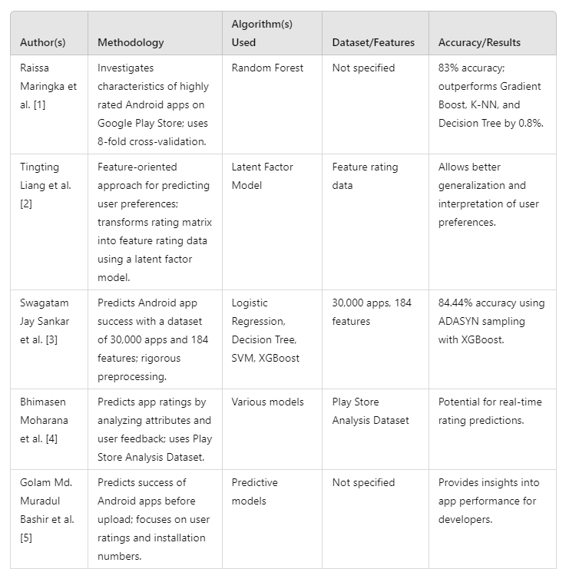
Literature Survey

Slide 6
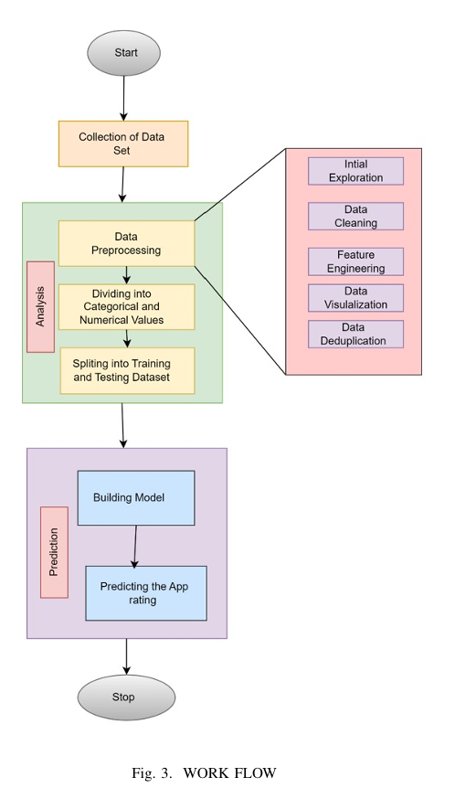
Proposed Flow
Each model was trained and evaluated using relevant performance metrics such as mean squared error (MSE), with the aim of identifying the most suitable approach for our predictive modeling task.
The evaluation process involved rigorous cross-validation techniques to ensure the robustness and generalization capability of the selected models.
By systematically comparing the performance of these diverse regression algorithms, we aimed to identify the optimal solution for our specific dataset and prediction objectives.

Slide 7
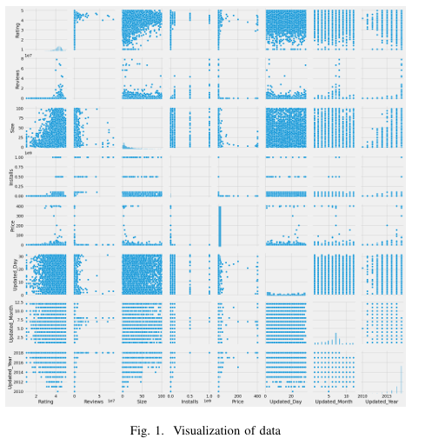
Dataset Description
The dataset comprises a total of 13 attributes, including ’app’, ’category’, ’rating’, ’reviews’, ’size’, ’installs’, ’type’, ’price’, ’content rating’, and others.
It’s important to note that app ratings fall within the range of 0 to 5. Following the application of preprocessing techniques aimed at removing outliers, missing, and noisy data, we eliminated unwanted information.
To gain deeper insights into the data, we employed visualization techniques. Initially, we explored various compatible plots for each relevant attribute, allowing us to better under stand the dataset’s characteristics and distributions.

Slide 8
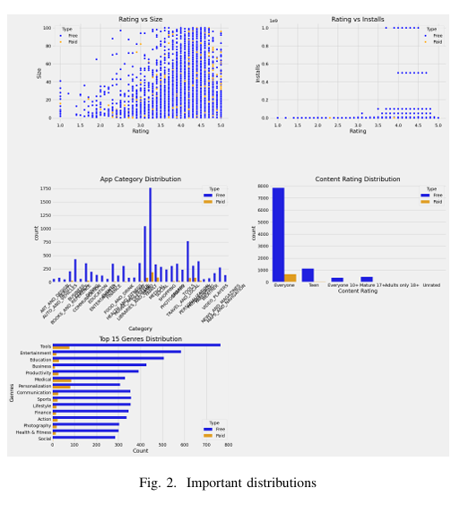
Attribute Comparison
1. Rating vs Size Scatter Plot: Visualizes the relationship between app ratings (x-axis, 0 to 5) and sizes (y-axis). Each point represents an app, with colors distinguishing free (blue) and paid (orange) apps.
2. Rating vs Installs Scatter Plot: Shows the relationship between app ratings (x-axis) and number of installs (y-axis).
3. App Category Distribution Bar Plot: Displays the distribution of apps across different categories. Bars represent categories, number of apps, and colors differentiating free and paid apps.
4. Content Rating Distribution Bar Plot: Illustrates the distribution of apps based on content ratings (e.g., Everyone, Teen, Mature). Bars represent content rating categories, app count (free and paid apps.)
5. Top 15 Genres Distribution Bar Plot: Shows the distribution of apps across the top 15 genres. The y-axis lists genres and the x-axis represents app count.

Slide 9
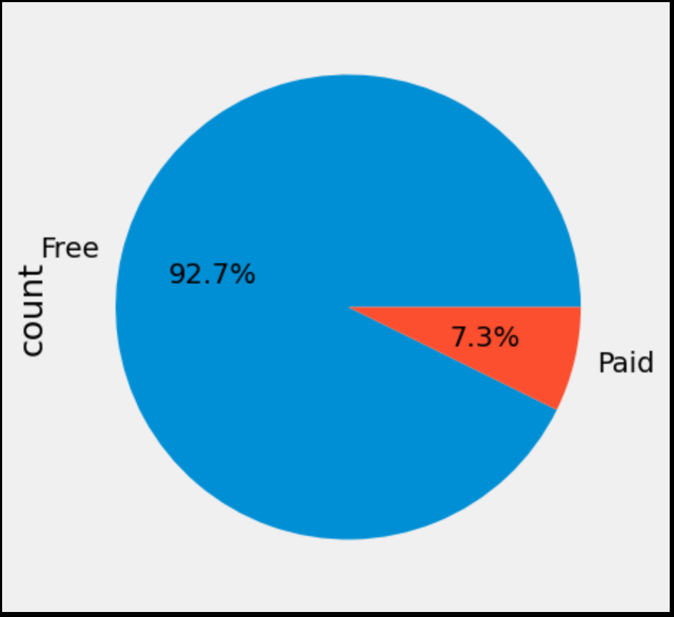
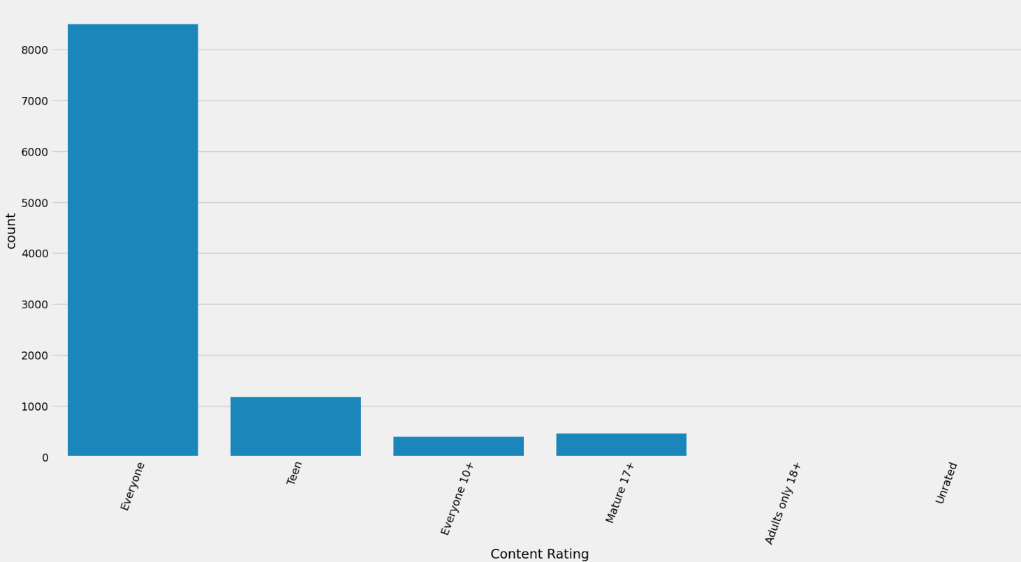
Preprocessing
Fig.4 Type
Fig.5 Content Rating

Slide 10
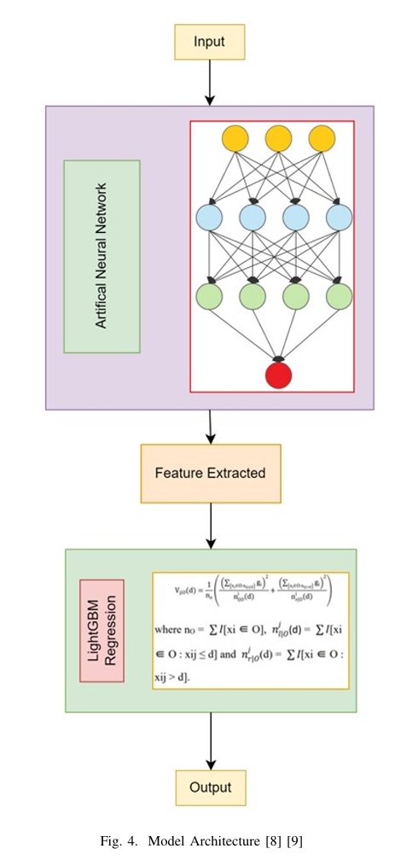
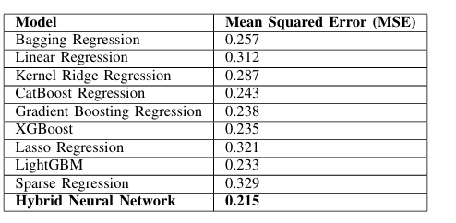
Existing Models Comparision

Slide 11
“This approach suggests you that predictions can be made even before the app is uploaded, helping developers make informed decisions during the development phase and Users make informed decision making in app suitability”

Slide 12
Conclusion
This research presents a comprehensive study on mobile application analysis and rating prediction using various regression techniques. We compared ten models, including Bagging Regression, Linear Regression, and a novel Hybrid Neural Network approach. The Hybrid Neural Network outperformed traditional models in predicting app ratings, showcasing superior accuracy. By combining deep learning for feature extraction with classical regression techniques, it achieved the best results in terms of Mean Squared Error (MSE). This study provides valuable insights for developers and users, enhancing decision-making and user experience in app stores. The Hybrid Neural Network offers a promising method for accurate rating prediction.

Slide 13
References
[1]Raissa Maringka, Sri Wenny Novitasari, Rianto Arief Wibowo, ”Classifi cation of Highly Rated Android Applications Using Machine Learning”, 2019 International Conference on Information and Communications Technology (ICOIACT), IEEE, 2019.
[2] Tingting Liang, Bo Wang, Changqing Zhou, ”User Preference Predic tion on Mobile Applications”, 2019 11th International Conference on Wireless Communications and Signal Processing (WCSP), IEEE, 2019.
[3] Swagatam Jay Sankar, Sandhya Priya T, Sindhu K, Gitanjali S, ”A Study on the Success of Android Apps using Machine Learning Tech niques”, 2019 International Conference on Computational Intelligence and Knowledge Economy (ICCIKE), IEEE, 2019.
[4] Bhimasen Moharana, Debasis Dash, ”App Rating Prediction and Anal ysis Using Machine Learning”, 2019 International Conference on Intel ligent Sustainable Systems (ICISS), IEEE, 2019.
[5] Golam Md. Muradul Bashir, Md. Moniruzzaman, ”Android App Success Prediction using Machine Learning: A Case Study on Google Play Store”, 2020 11th International Conference on Computing, Communi cation and Networking Technologies (ICCCNT), IEEE, 2020.
[6] Bhramara Bar Biswal, Chiranjeeb Pati, ”Mobile App Quality Assessment using Predictive Modeling”, 2020 6th International Conference on Advanced Computing and Communication Systems (ICACCS), IEEE, 2020.

Slide 14


